Slide 1
Vulcan Activity Tracker
CMSC-4920-Senior Project 2
Group2
Team: Margo Bonal, John Gerega, Luke Ruffing

Slide 2
Project Description
The Vulcan Activity Tracker is an athletic app that allows for the tracking of all campus athletics activities.
In one combined platform, the Vulcan Activity Tracker aspires to meet student organization needs, social interaction, and exercise goal planning in a free accessible way!

Slide 3
Weekly Progress
GOALS
Final Presentation Slides Progress
Picked up printed User Manual
Practiced presentation
Finished documentation website
Prepared app paragraph
Filled database with test accounts

Slide 4
Challenges
Solutions
PennWest internet blocking App url
Fix any remaining errors
Presentation time limit
Send email to Utech
Group testing and debugging
Scheduled additional practices

Slide 5
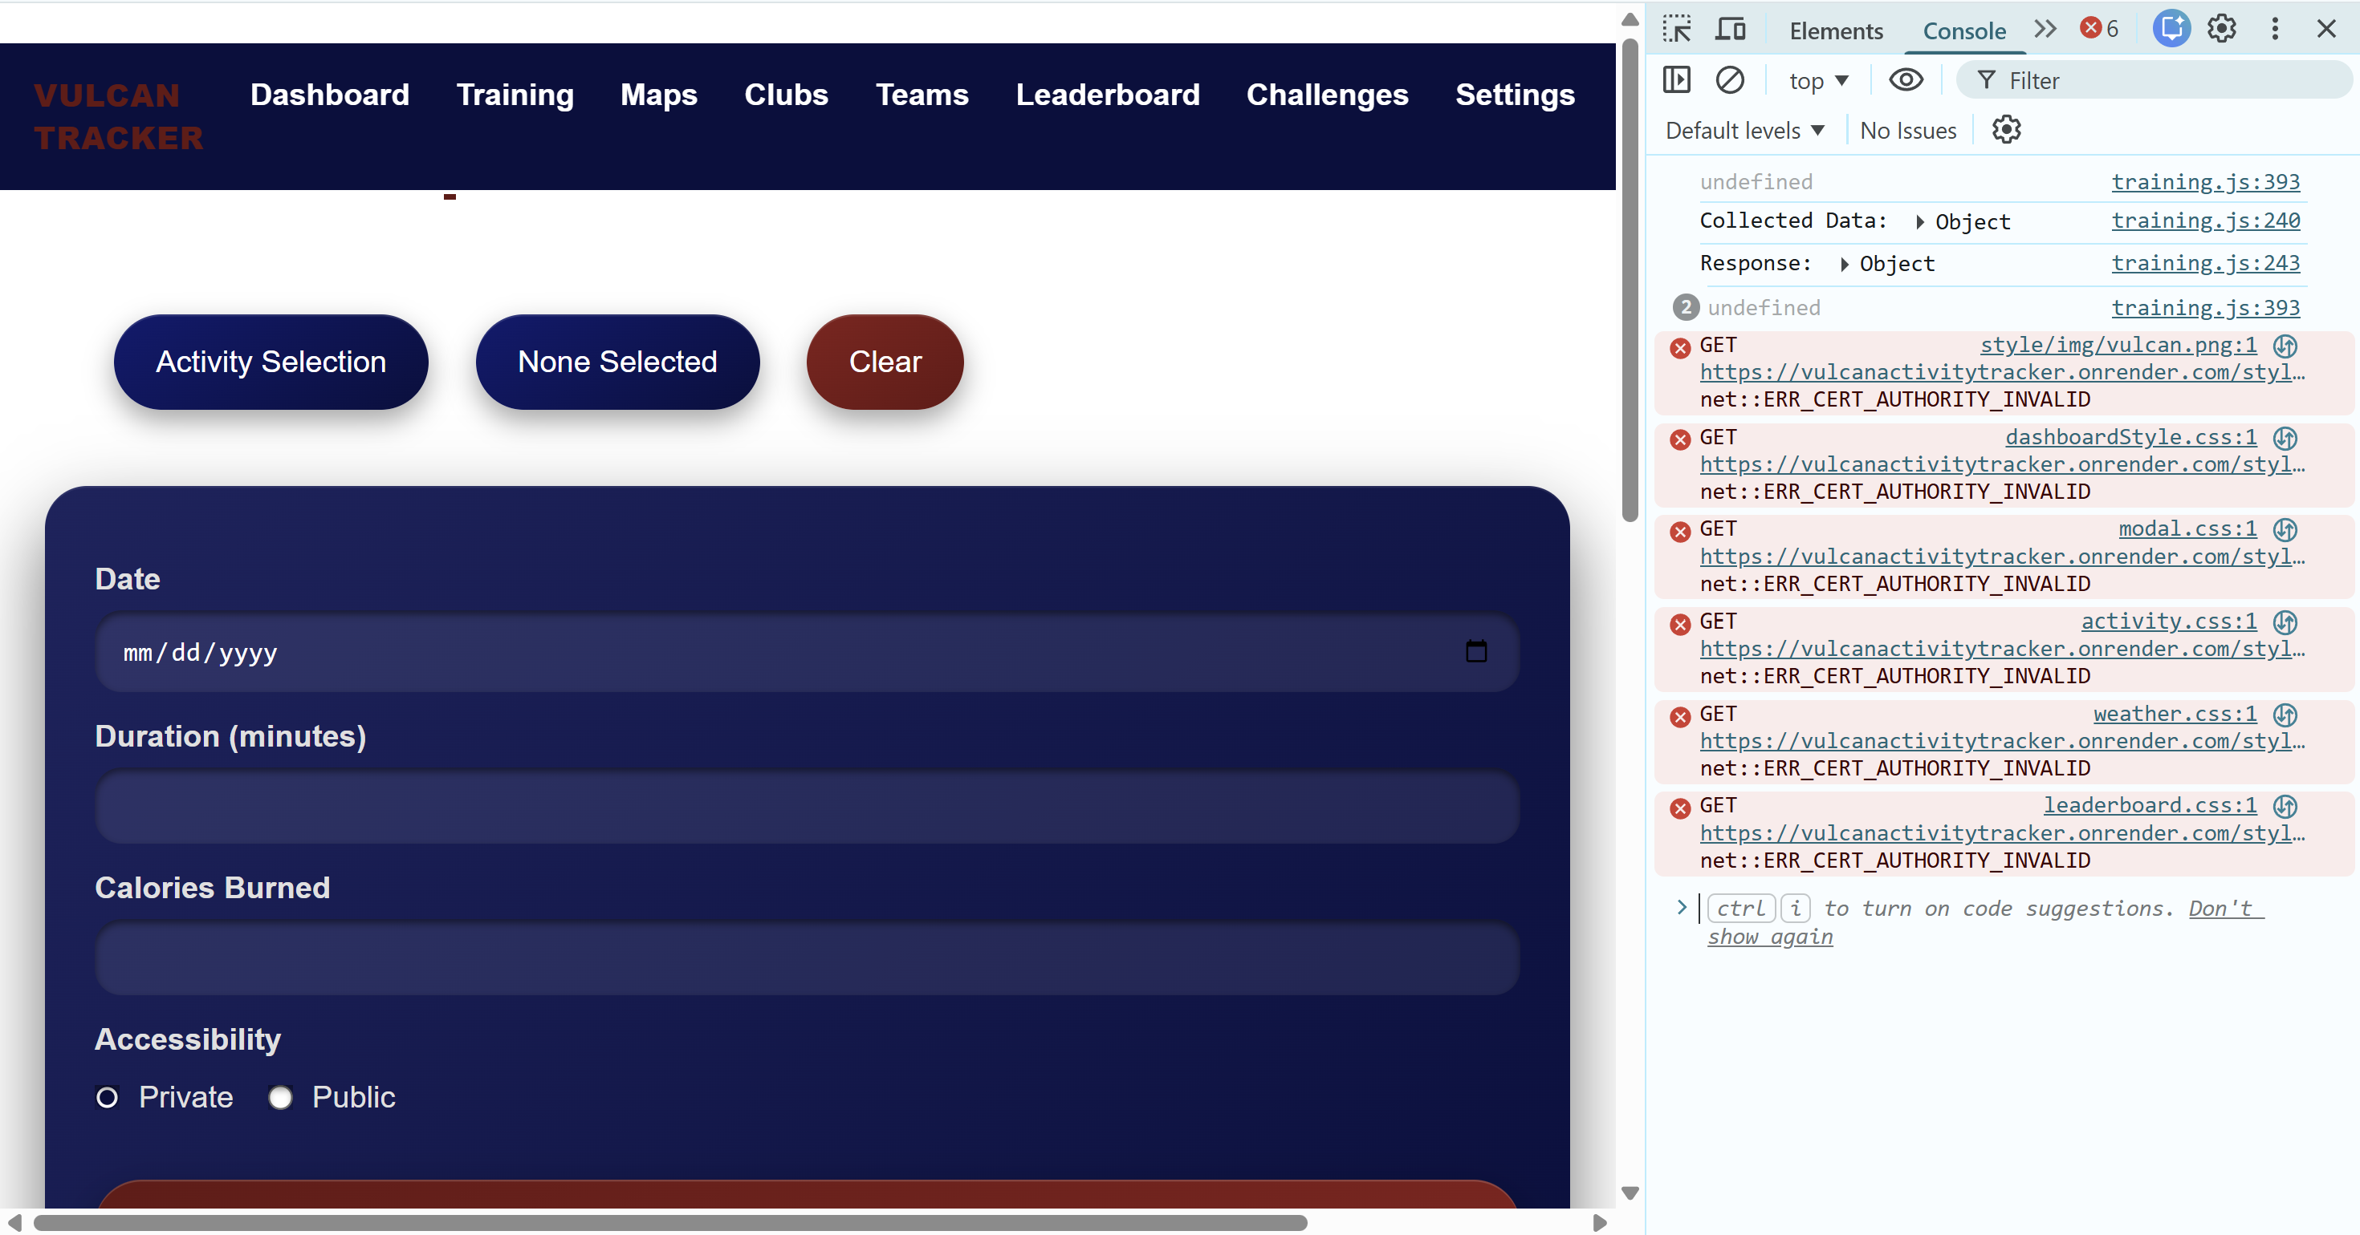

Slide 6
Progress
Vulcan Platform
Database

Slide 7
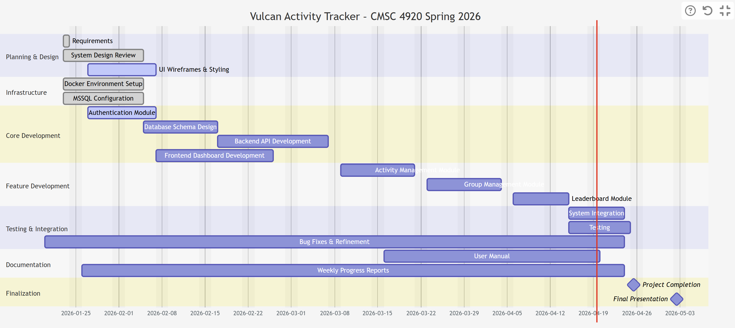
Planning
Gant chart

Slide 8
Documentation: https://jjdeuce06.github.io/VulcanActivityTracker/
Live: https://vulcanactivitytracker.onrender.com

